Slide 1
Game Art Introduction Assessment 2
Asish sharma

Slide 2
Introduction
Introduction:
This assessment will examine the processes of planning, designing and creating a simple and efficient 3D asset, in line with a brief, for use in a real-time engine.
The assessment will include:
Analysing a brief.
Gathering reference and developing simple concepts.
Editing asset lists and setting naming conventions.
Modelling, UV unwrapping and texturing a simple object.
Lighting and presenting the asset in a real-time engine.
Gathering and addressing feedback and conducting a post mortem review.
The assessment instructions:
All sections marked in green must be edited/filled out by each student. Be sure to replace “Student Name” on the first slide and the in the document title with your name.

Slide 3
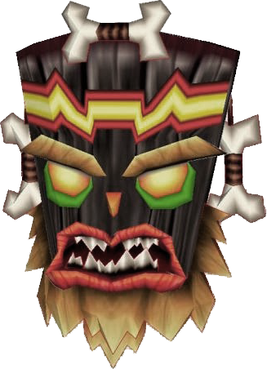
Brief|Overview & Requirements
Overview:
Utilising polygon modelling techniques create an asset suitable for a game engine
to be uploaded into either a game engine, Sketchfab or similar.
Model:
Your model must meet the technical requirements set in the the asset list.
Your mesh topology and UV layouts must be clean and efficient.
Textures:
Textures must meet the technical requirements set in the the asset list.
Textures are to be exported in an appropriate format. E.g. PNG. JPG. TGA. etc.
Presentation:
The final asset is to be uploaded to real time engine and lit appropriately.
Example: "uka uka" crash bandicoot

Slide 4
Brief|Asset options
Assets
Here is a list of the assets that you can choose from:
Lightsaber
Sword
Mace
Hammer
Shield
Barrel
Crate
Helmet
Lantern
Doorway
Mask
Skateboard

Slide 5
Task|Description
Description Task:
Considering the brief, write a story in the slide below that describes your model (50 Words).
Eg, A battered old mask made of scarred wooden panels with rusty metal, studded banding. There is a large tarnished gold emblem with a skull motif embedded in the forehead of the mask. The lower section of the mask is smattered with barnacles and its loosened panels are warped from being half submerged in wet sand. The mask was washed up on a deserted beach many years ago and was once part of a great treasure, but is now little more than driftwood.
Include:
What are the materials it is made from (wood, metal etc)?
What is its condition/age?
Where was it found?
How did it get there?
What was its purpose?
Any other features.
Asset List:
Update the naming conventions for your asset and its associated textures on the next slide.

Slide 6
Description/Asset List
Asset Description:
A Beer Bottle is a bottle designed as a container for beer. Such designs vary greatly in size and shape. It is transparent and made up of glass to create a clear visibility through the bottle. The beer bottle is brand new and will be released in 2020.
Asset | Polycount | Textures | Tex. Size | Texture Name | Notes
AsishSharma_Asset01_BeerBottle.fbx | <1500 Tri’s | Diffuse (Alpha) Specular Normal | 1024 1024 1024 | Bottle_Back01_.png Bottle_Front01_.png Bottle.PSD | Beer Bottle

Slide 7
Task|Reference
Reference Tasks:
Gather reference images for your asset, include material reference and consider the colour palette. Paste the images into the slide below.
Requirements:
Add notes where relevant and crop images so that they only include the important elements.

Slide 8

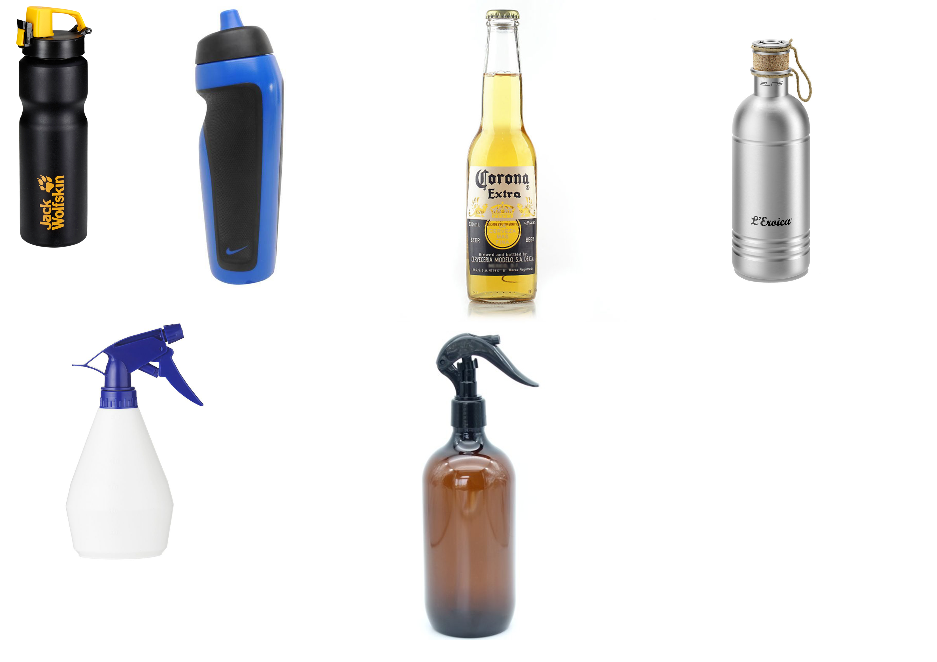
Reference
Paste your images into the green box

Slide 9
Task|Concepting
Concepting Tasks:
Create at least 3 thumbnails sketches of your asset and paste them into the slide below.
Requirements:
Thumbnails must include the overall form and major details.

Slide 10
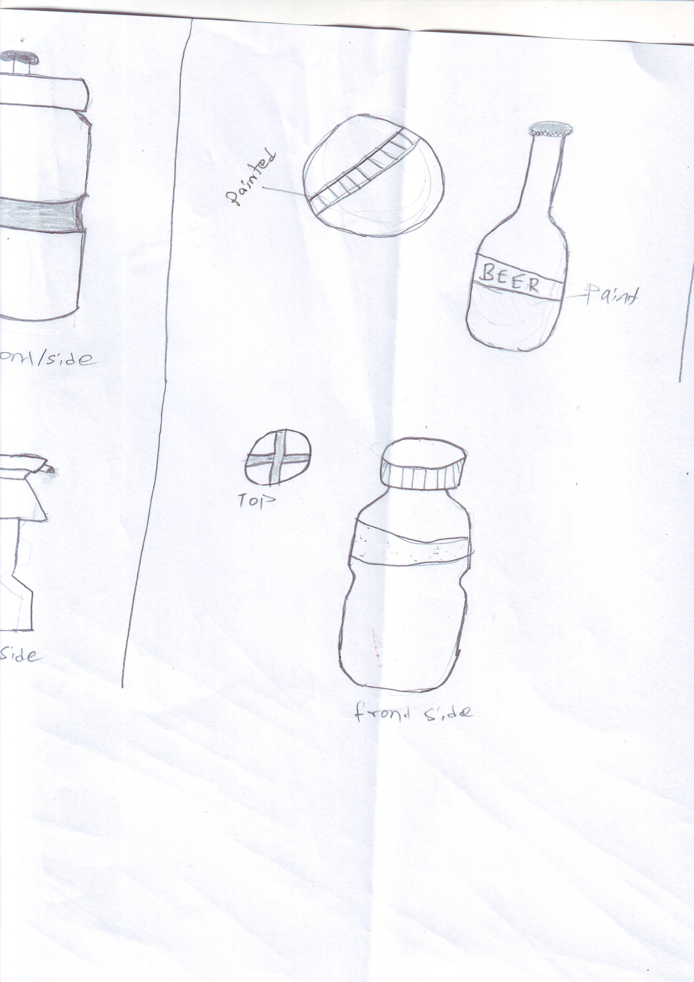
Thumbnails
Paste your images in the green boxes

Slide 11
Task|Primitive Blockout
Blockout Tasks:
Using only primitives create a primitive blockout of your asset.
Screen capture the blockout and blockout silhouette in the Maya viewport and paste them into the slide below.
Requirements:
The blockout should be the correct scale and represent the key forms of the design.

Slide 12
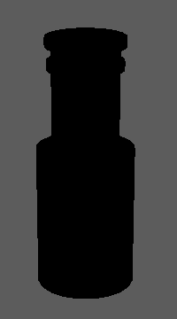
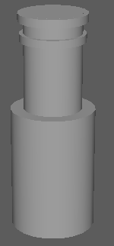
Primitive Blockout
Paste your images in the green boxes
Primitive Blockout
Silhouette

Slide 13
Feedback|Pre-production
Obtain approval for your pre-production before modelling your asset.
Feedback | Approved

Slide 14
Task|Modelling
Modelling Tasks:
In Maya create your asset using polygon modelling techniques.
Screen capture a perspective view of the model in shaded wireframe mode and paste it into the slide below.
UV Unwrap your mask model.
Take a UV snapshot of your mask’s UV layout and paste it into the slide below.
Requirements:
Your mesh must meet the brief and technical requirements.
Your mesh needs to be clean with efficient topology.
Use Mesh Cleanup and remove/fix any: N-gons, Hidden edges, Lamina faces or Isolated vertices.
Delete your history, freeze transforms, set your pivots, clean your outliner and ensure your Mesh is named appropriately.

Slide 15
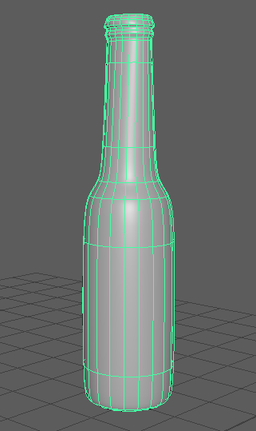
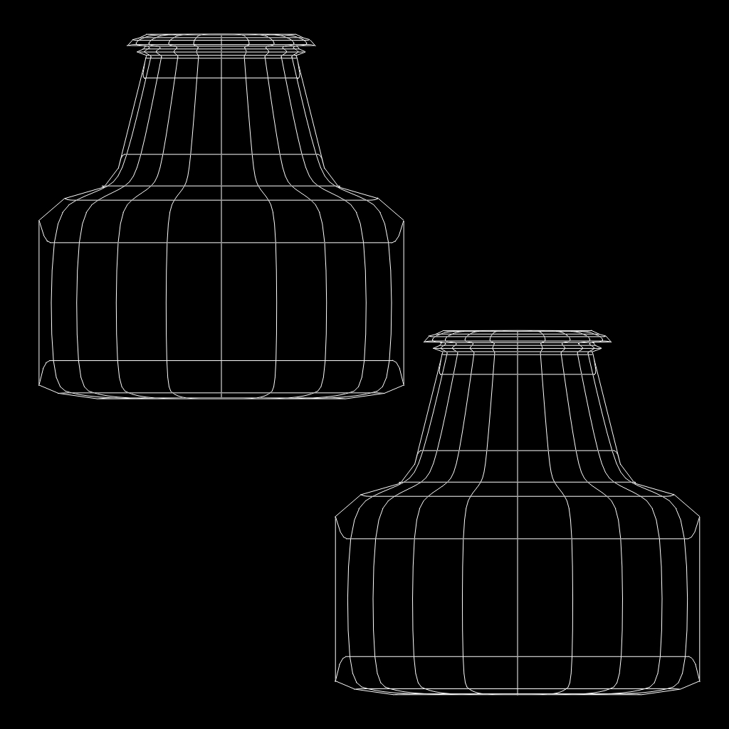
Modelling & UV|Asset
Paste your images in the green boxes
Perspective shaded wireframe
UV Snapshot

Slide 16
Feedback|Modelling
Obtain approval for your model and UV unwrap before texturing your asset.
Feedback | Approved

Slide 17
Task|Texturing
Texturing Tasks:
Gather or create images to create the required texture maps.
Paste the textures into the slide below.
Screen capture a perspective view of the model with the textures applied and paste it into the slide below.
Maps required:
Diffuse map
Normal map
Requirements:
Export your individual maps in an appropriate format using the naming conventions set in the asset list.
Ensure your model uses no more than two materials, which must be named appropriately.

Slide 18
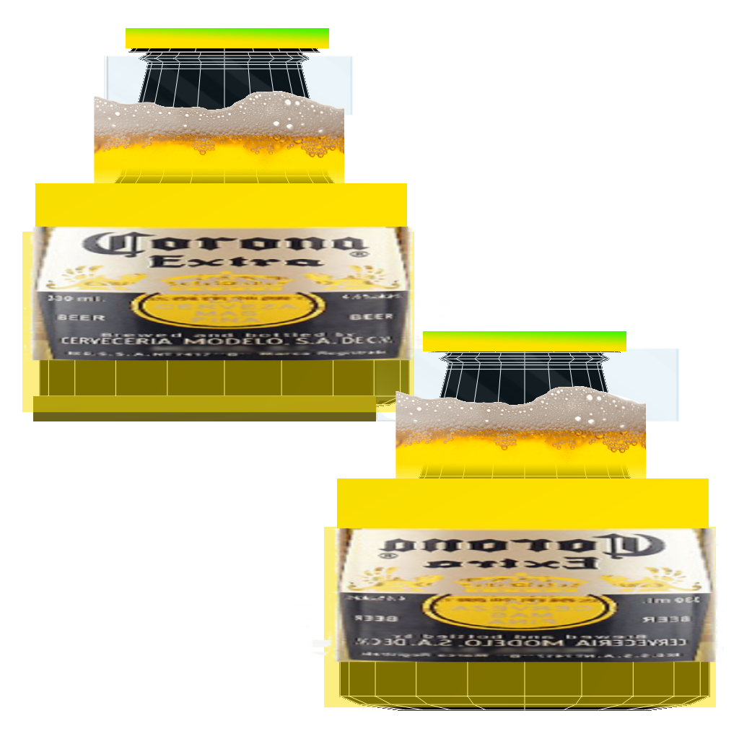
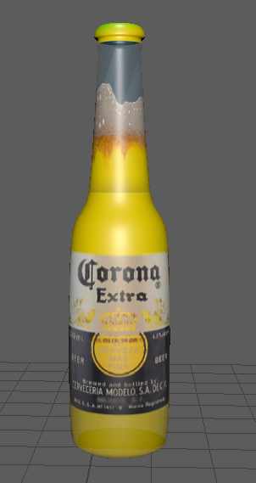
Textures|Asset
Paste your images in the green boxes
Diffuse
Specular
(if created)
Normal
Textured Model

Slide 19
Task|Upload
Upload Tasks:
Import your model into the game engine OR Upload your model to sketchfab. https://sketchfab.com/
Apply all required materials and textures.
Adjust the scene lighting and post processing filters.
Take a screenshot/beauty render in engine or from sketchfab and paste it into the slide below.
Requirements:
Use appropriate descriptions and tags.

Slide 20
Upload|Sketchfab
Paste your image in the green box
Sketchfab Beauty render
Paste a link to your sketchfab gallery here

Slide 21
Task|Post Mortem
Post Mortem Tasks:
Answer all the questions in the post mortem slide below.
Requirements:
All questions must be answered in sentences (25 Words).
Be sure to check your spelling, grammar and punctuation.

Slide 22
Post Mortem
Did the asset turn out as you expected?, If so how is it different?
Yes, the asset turn out as I expected because the model has the matching shape and texture.
What was challenging in its creation?
The challenging in this creation was UV unwrapping as texture were not applying properly to the model so the texture quality is very low.
What are you most proud of about the asset?
I am very proud of the shape and the texture of my asset as it has a great shape with good quality of texture.
What would you do differently?
I would do UV unwrapping differently by using the cut and sew tools which would allow me to use the texture on the right place of the model.
What new skills / things did you learn?
The new skills and things I learnt were, modeling, unwrapping, applying correct texture to the model as well as the shortcut key.

Slide 23
Feedback|Final
Obtain approval for the final deliverables of the assessment.
Feedback | Approved

Slide 24
Task|Submission
The following files Must be given to your teacher in an appropriate format.
Meshes:
All of your mesh files in both .mb and .fbx format.
YourName_Assess1_AssetName1.ma
YourName_Assess1_AssetName1.fbx
Textures:
Your Photoshop .PSD texture files.
YourName_Assess1_AssetName1.psd
All individual exported texture images in .tga format.
AssetName1_D.tga
AssetName1_S.tga
Presentation:
Your power point must be submitted to Canvas.
YourName_Assess1_Presentation.ppt
Sketchfab:
Your model must be imported into your game engine or uploaded to Sketchfab as a single mesh.

